Slide 1

WINNING SPACE RACE WITH DATA SCIENCE
ANESHA NAGARAJAN
MAY 17 2024

Slide 2
OUTLINE
Executive Summary
Table of Contents
Introduction
Methodology
Results
Conclusion
Appendix

Slide 3

EXECUTIVE SUMMARY
The Aim of this is to predict whether SpaceX Falcon9 first stage landed successfully or not using various Machine learning Algorithms.
Various phases of this project includes
Data Collection and Wrangling
Exploratory Analysis using SQL and Data Visualization techniques
Interactive map with Folium
Building Dashboard with Plotly Dash
Predictive analysis
Report will conclude us
Data analysis reports
Data Visualization with Interactive Dashboards
Various Predictive analysis models to excel the performance

Slide 4
INTRODUCTION
In this project, Space X Falcon 9 rocket launches space of 62 million dollars; other providers cost upward of 165 million dollars each, much of the savings is because Space X can reuse the first stage.
Therefore, if we can determine if the first stage will land, we can determine the cost of a launch.
This information can be used if an alternate company wants to bid against space X for a rocket launch.
In this project, we use different machine learning pipeline to predict if the first stage will land given the data.

Slide 5

METHODOLOGY

Slide 6
METHODOLOGY
Executive Summary
Data collection methodology:
Using SPACEX Rest API.
Perform data wrangling
Data is being filtered.
Dealing with Missing values.
Perform exploratory data analysis (EDA) using visualization and SQL
Perform interactive visual analytics using Folium and Plotly Dash
Perform predictive analysis using classification models
The machine learning prediction models used are
Logistic regression
Support Vector machine(SVM)
Decision Tree
K-Nearest Neighbors
The information is out in open-source Wikipedia. Using Web scrapping technique data is retrieved.

Slide 7
DATA COLLECTION
Data Collection is the process retrieving data from various sources required for the data insights to be delivered to Stakeholders. In this case, we use
Space X API:
The request being send to "https://api.spacexdata.com/v4/rockets/ API and saved in a response variable.
The dataset has complete details about the flights that have been launched by Falcon 1 and 9, we have filtered the data to the flights that have been launched by Falcon 9
Web Scrapping data from WIKI
Used BeautifulSoup to scrap the flight details launched by Falcon 9.

Slide 8
DATA COLLECTION BY API
Request rocket launch data from Space X API
using .json() method data covert to dataframe and normalized using .json_normalize()
by using various functions the necessary data is being extracted
constructing dictionary from data
transforming dictionary to DataFrame
Filter data for only rockets launched by Falcon 9
Replacing the missing values of the column by the mean of the column
Export data to csv
Data Collection by API GitHub Link

Slide 9
DATA COLLECTION BY WEB SCRAPPING
Request rocket launch details from Wikipedia
Using BeautifulSoup from the HTML response
Extracting column names from the HTML header
By parsing the table tags
Construct Dictionary from the data
Convert dictionary to DataFrame
Export the data to csv
Data Collection by WebScraping GitHub Link

Slide 10
DATA WRANGLING
Exploratory Data Analysis is being done for the dataset
Find the null values in the columns
Calculating total no. of launches in each Launch site
Finding the the number and occurrence of mission outcome of the orbits
The class of outcome with 1 means the rocket landed successfully else it got failed
Using EDA obtain the training dataset
Find if there is null values
Class of 1 means landed successfully else failed
Data Wrangling GitHub Link

Slide 11
EDA WITH DATA VISUALIZATION
EDA is the crucial part of Data analysis which involves studying, exploring and visualization information to derive a useful insights from the given data.
To find patterns, trends, and relationships in the data, it makes use of statistical tools and visualizations.
There are various libraries provided by Python Numpy, Pandas, Matplotlib, Seaborn, Plotly.
We used SCATTER PLOT, LINE PLOT, BAR CHART in order to find the relationship between two variables and also between multiple variable or in a specific category.
Data visualization Github Link

Slide 12
EDA WITH SQL
EDA with SQL GitHub Link

Slide 13
Build an Interactive Map with Folium
We use data visualization by libraries such as
Plotly
Matplotlib
Seaborn
For Interactive map with Folium, we use
Folium
Markers and MarkerCluster
Folium helps to mark circles and popup the map location of the launch site. And provides green (for successful launch), red (for failure launch). It is easy to differentiate.
It also helps to find the proximity distance between the launch site and the coastal area or any highways/railways (for any place)
Interactive Map with Folium GitHub Link

Slide 14
Build a Dashboard with Plotly Dash
Functions from the Dash is used to toggle between the input to see the visualization of how the data is distributed using PIE CHART.
We do have one more parameter of Payload which can be changed using the dropdown.
The pie chart shows the Failure launch and success launch which is easy to differentiate.
Scatter plot use to show us the correlation between Payload and Success launch.
Dashboard with Plotly Dash

Slide 15
Predictive Analysis (Classification)
Data has to be split into train and test using train_test split() method.
Variuos statiscal models have been used. Parameters are selected.
Model is initiated, Gridsearch is used to split the data with different split combination anf fit the model.
Find the accuracy score to check the performance.
Predict yhat using ytest value, confusion matrix is used to show the performance of the model.
Standardizing the
Data using standard
Scaler().
Predictive Analysis GitHub Link

Slide 16
Results
The Result shows our data comes under Classification model which 1 means successful launch and 0 means failure launch.
The prediction is evaluated using various technique
Missing values is been replaced by mean of the data column
Using SQL, we query to the database to find the numbers, counts and necessary information
By using data visualization, we came to know relationship between two or more variable or a specific category of variables
By Folium, MarkerCluster showcased where our Launch sites reside and finding proximity distance
Predictive Analysis helps to fit the model with 70% data and test with 30% and calculate the performance of the model by measurement techniques

Slide 17

Insights drawn from EDA

Slide 18
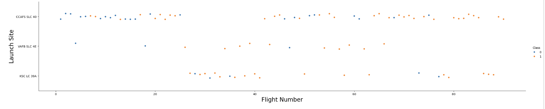
Flight Number vs. Launch Site
There were failures in launches at first, but it got succeed later.
We can infer that launch site CCAFS SLC 40 has highest flights landing compared to other launch sites.
It can be assumed that each new launch has high success rate.

Slide 19
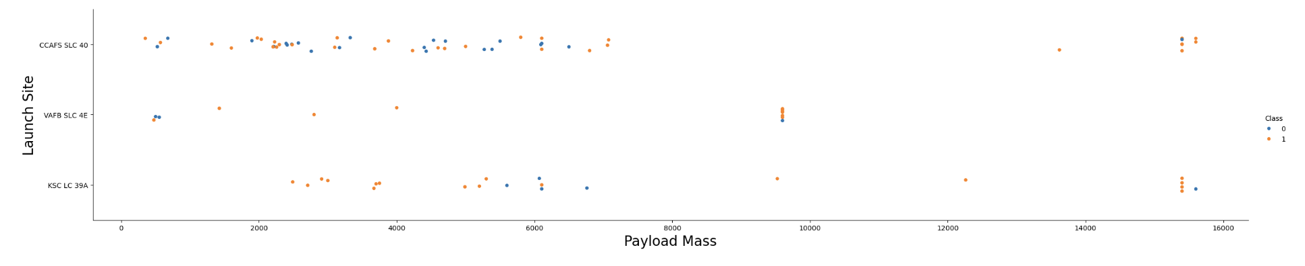
Payload vs. Launch Site
For every launch site, the higher the Payload the higher the success rate.
Most of the launches with Payload larger than 7000 kg has successful rate.
Over 15000kg payload can be successfully handled by CCAFS SLC 40 and KSC LC 39A.

Slide 20
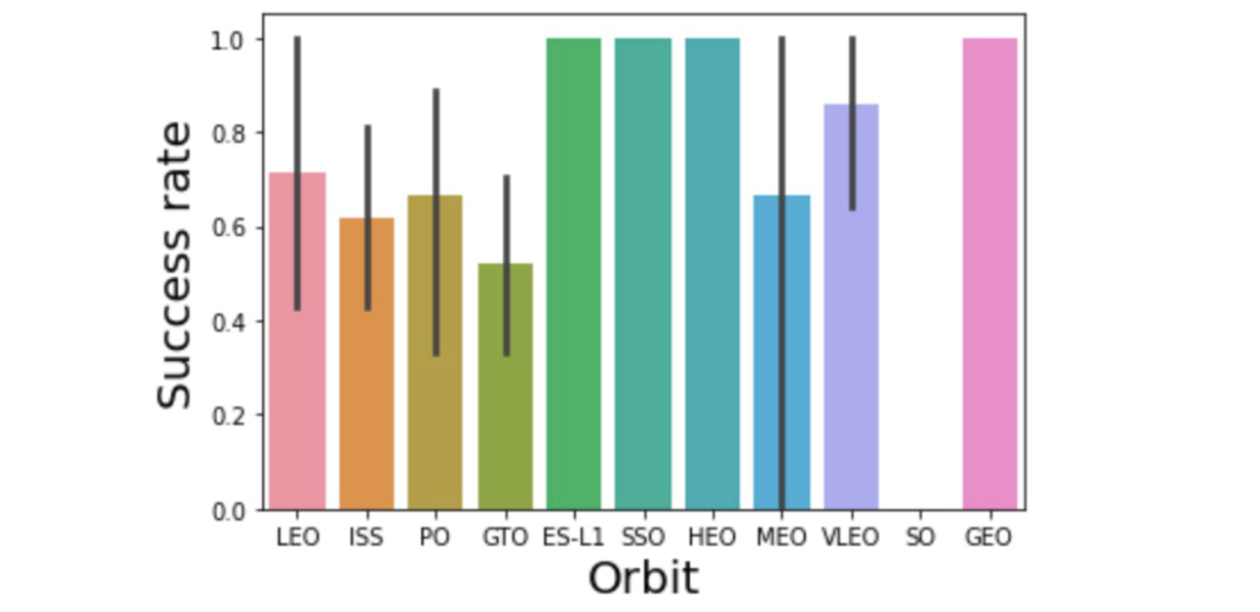
Success Rate vs. Orbit Type
The orbit type ES-L1, SSO, HEO, GEO have 100% success rate.
The VLEO has more or less 85% success rate.

Slide 21
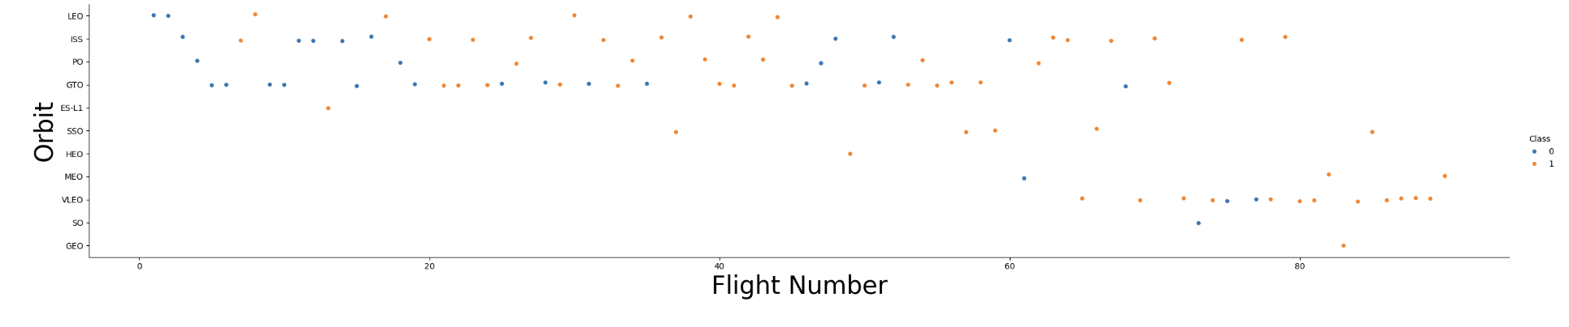
Flight Number vs. Orbit Type
Most Flights use the orbit type of VLEO, LEO, ISS, PO, GTO.
Almost 80% of the flights landed successfully in VLEO.
ISS has also most success rate.

Slide 22
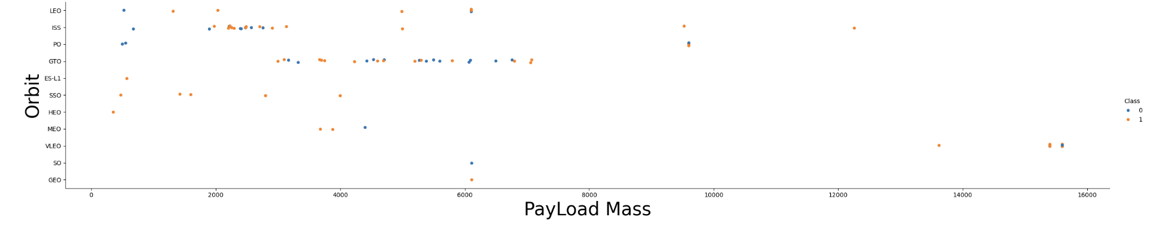
Payload vs. Orbit Type
ISS orbit type handles 2000-4000 kgs payload mass.
GTO takes 3000-7000 kgs payload mass.
Other orbit types has very minimal payload handling capacity.

Slide 23
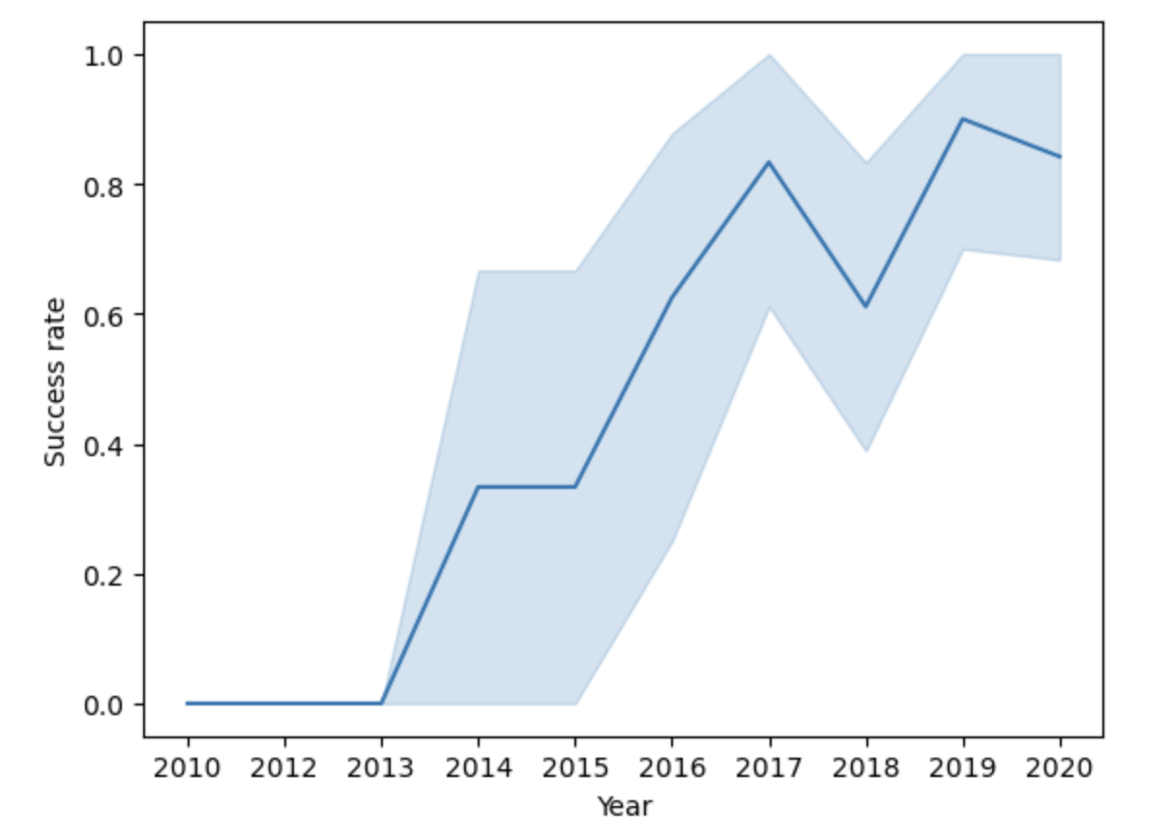
Launch Success Yearly Trend
The success rate increases from 2013 till 2021 had a slight drop in 2018.

Slide 24
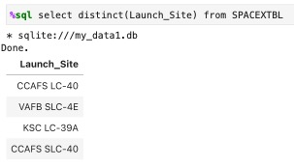
All Launch Site Names
There are four unique Launch sites for rocket by Falcon 9

Slide 25
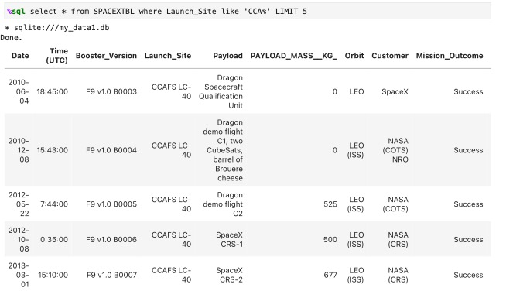
Launch Site Names Begin with 'CCA'
There are five records displayed the launch sites starts with ‘CCA’

Slide 26
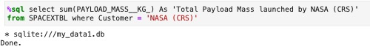
Total Payload Mass
Total Payload launched by NASA(CRS) is ‘45596’.

Slide 27
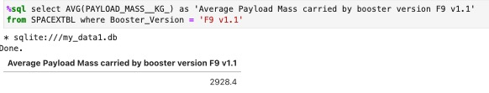
Average Payload Mass by F9 v1.1
Average Payload Mass carried by booster version ‘F9 v1.1’.

Slide 28
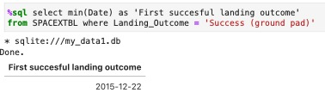
First Successful Ground Landing Date
The date that first landing outcome i.e ground pad.

Slide 29
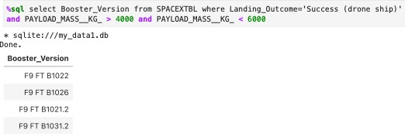
Successful Drone Ship Landing with Payload between 4000 and 6000
Successful Drone ship landing with Payload between 4000 and 6000.

Slide 30
Total Number of Successful and Failure Mission Outcomes
Total Number of Successful and Failure Mission Outcomes.

Slide 31
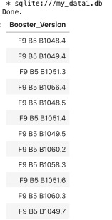
Boosters Carried Maximum Payload
There are 12 Boosters carried Maximum Payload

Slide 32
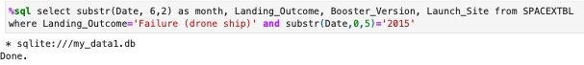
2015 Launch Records
Failure Drone Ship in the year 2015 and its Booster version.

Slide 33
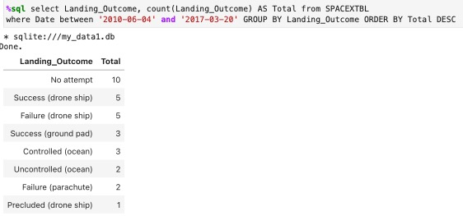
Rank Landing Outcomes Between 2010-06-04 and 2017-03-20
The landing outcome details are listed with different category between the dates ‘2010-06-04’ and ‘2017-03-20’.

Slide 34

Launch Site Proximity Analysis

Slide 35
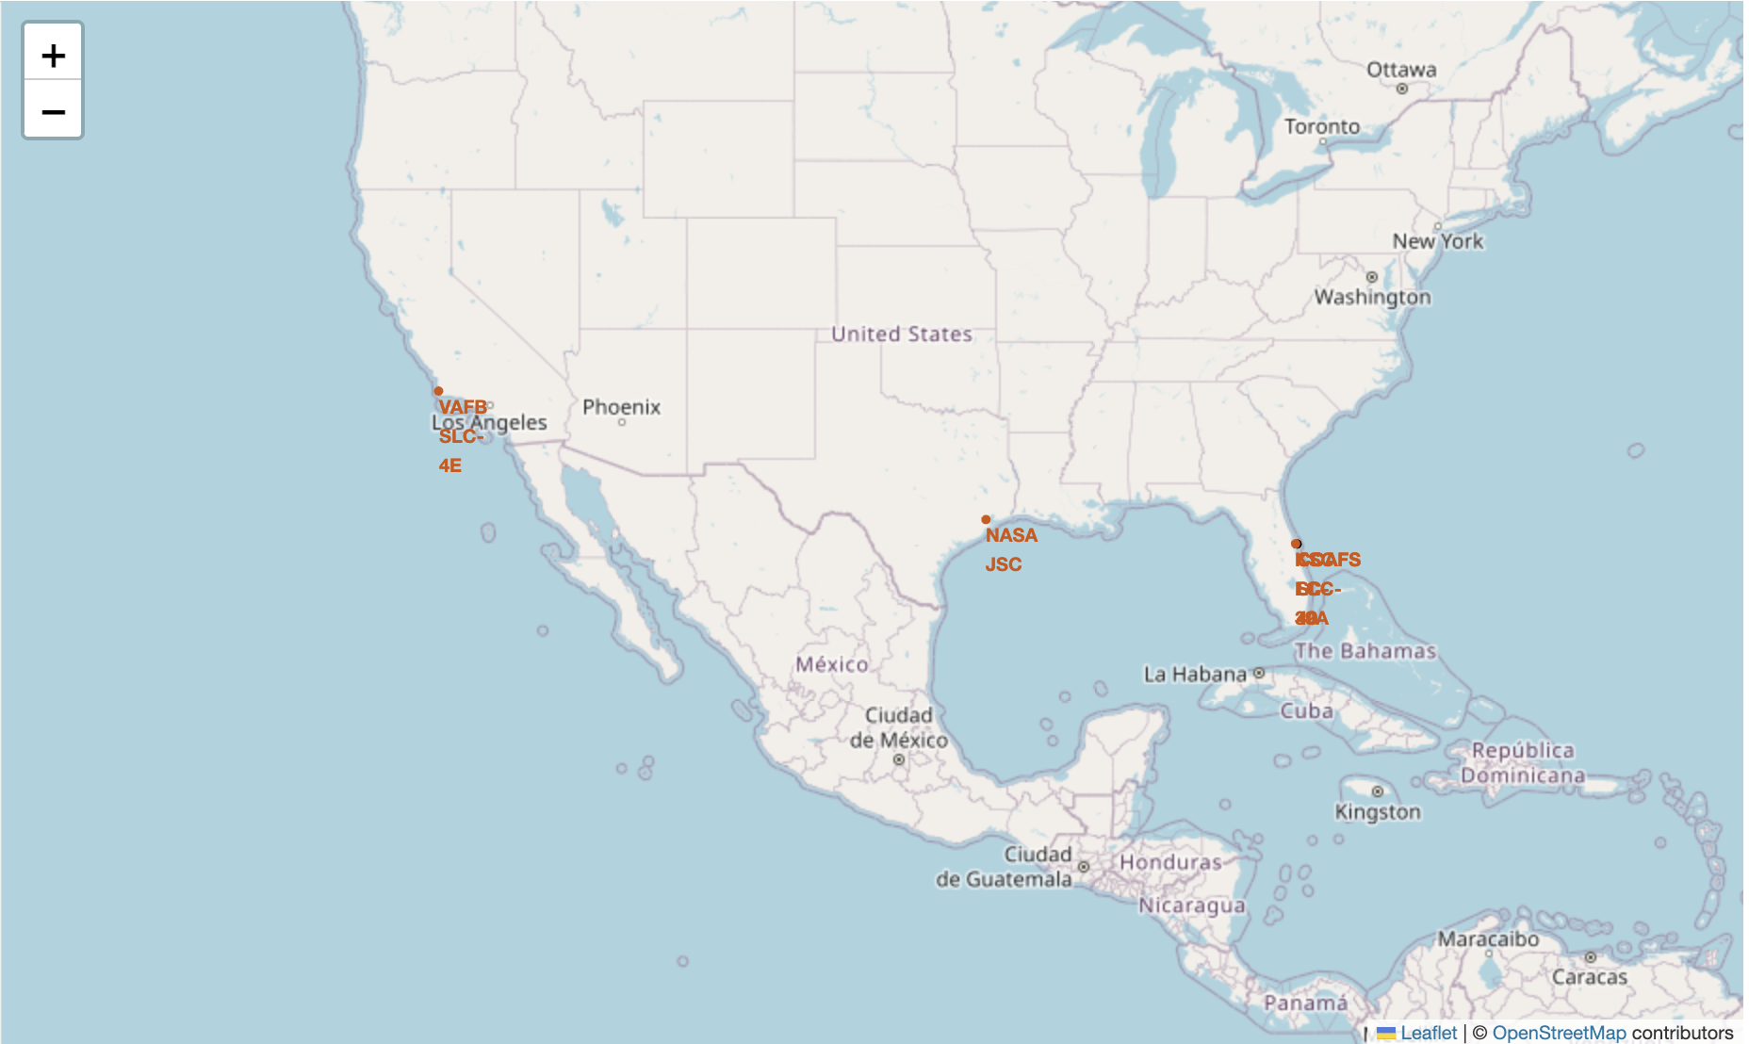
Launch site Map
There are four Launch sites.
CCAFS LC-40
VAFB SLC-4E
KSC LC-39A
CCAFS SLC-40
Using the Latitude and Longitude, Folium method the Launch sites are marked in the Map.

Slide 36
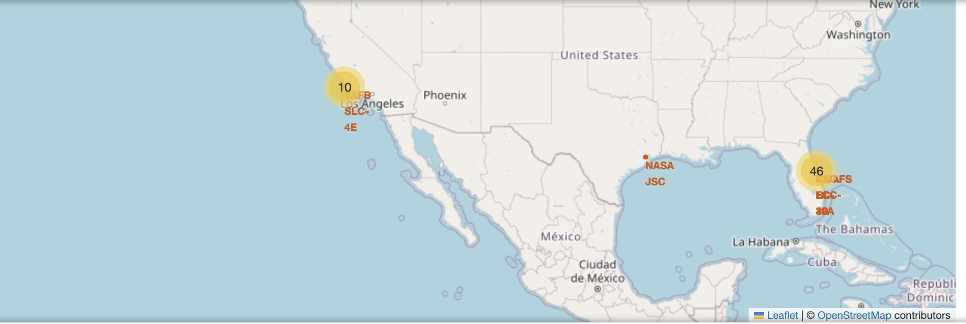
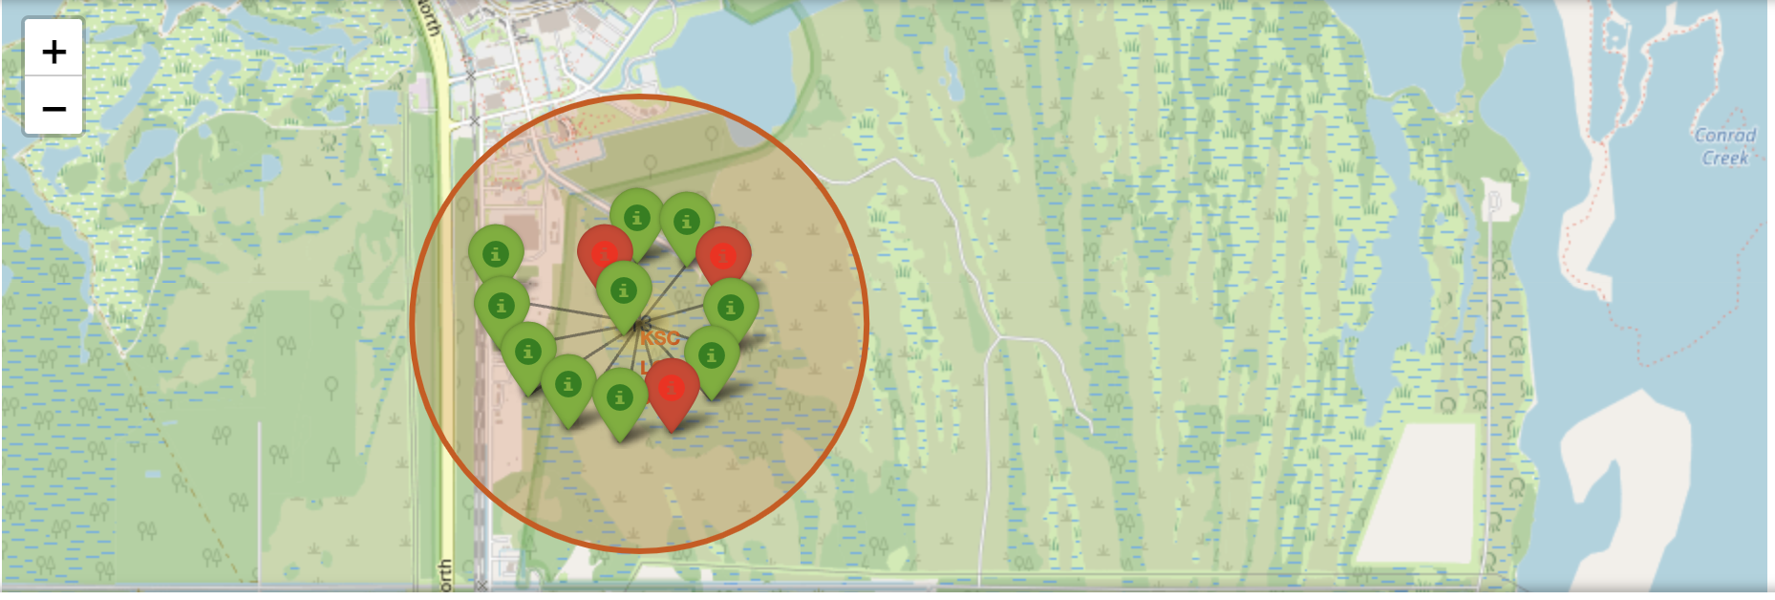
Success/Failed launches for each site on the map
By using Marker and MarkerCluster in Folium, we have cluster the launches and differentiate between the success/failure launches for each site.

Slide 37
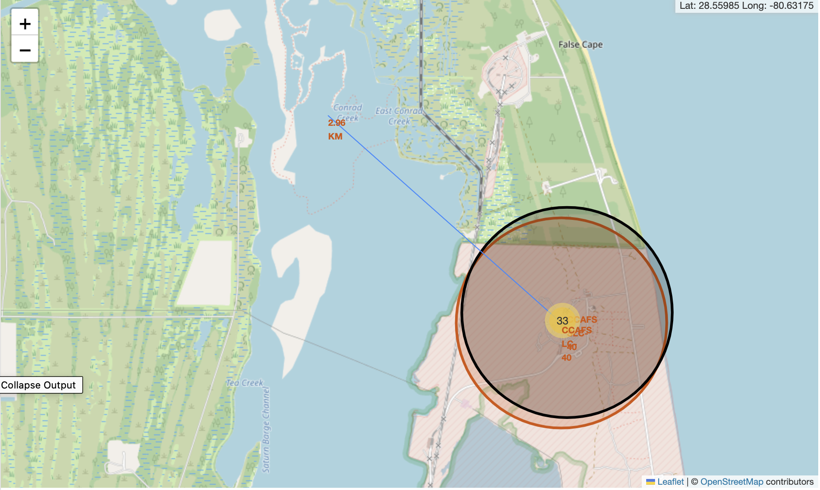
Distances between a launch site to its proximities
Distance from the Launch site to the coastal area proximity is being measured using Folium

Slide 38

Build a Dashboard with Plotly Dash

Slide 39
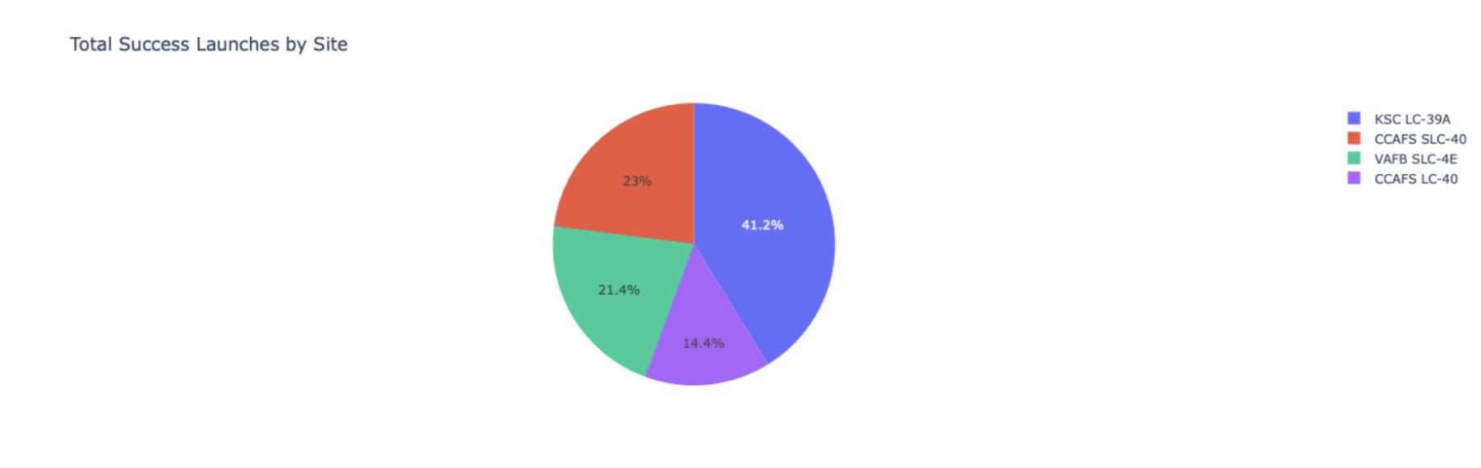
Launch Success count for all sites
KSC LC – 39A has highest number of Success launch among other sites

Slide 40
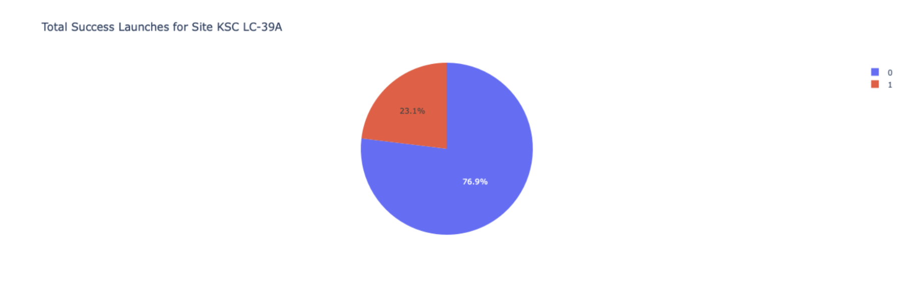
Launch site with highest success ratio

Slide 41
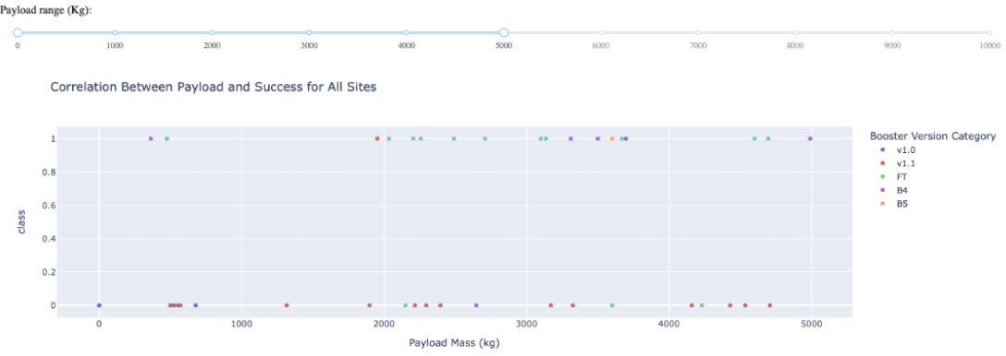
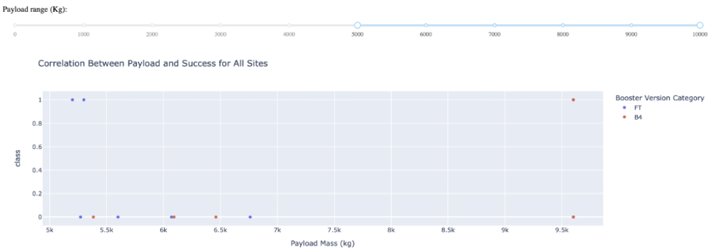
Correlation between Payload and Success launch site
Scatter plot shows the range of payload mass with success in all launch sites 0 means failed launches. 1 means success launches.

Slide 42

Pedictive Analysis(Classification)

Slide 43
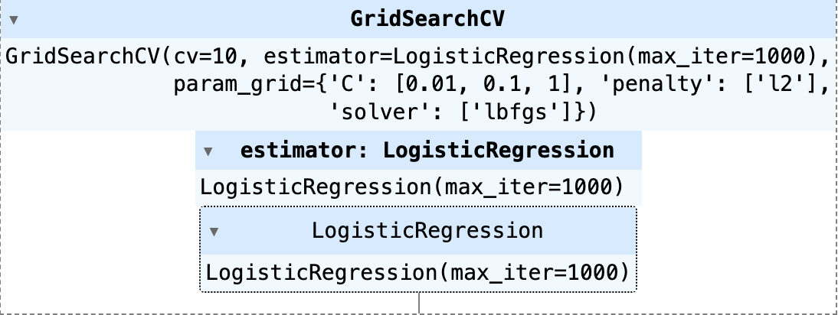
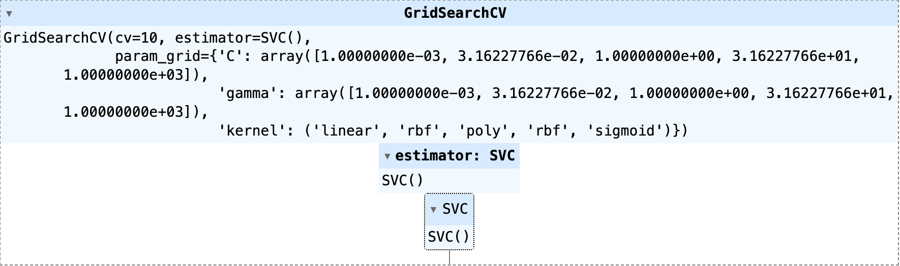
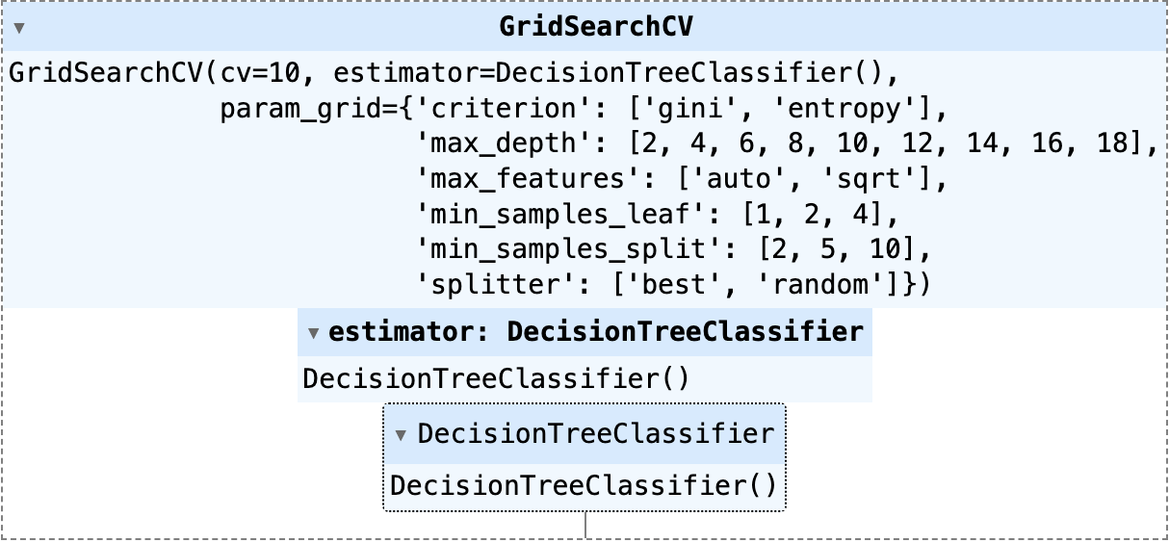
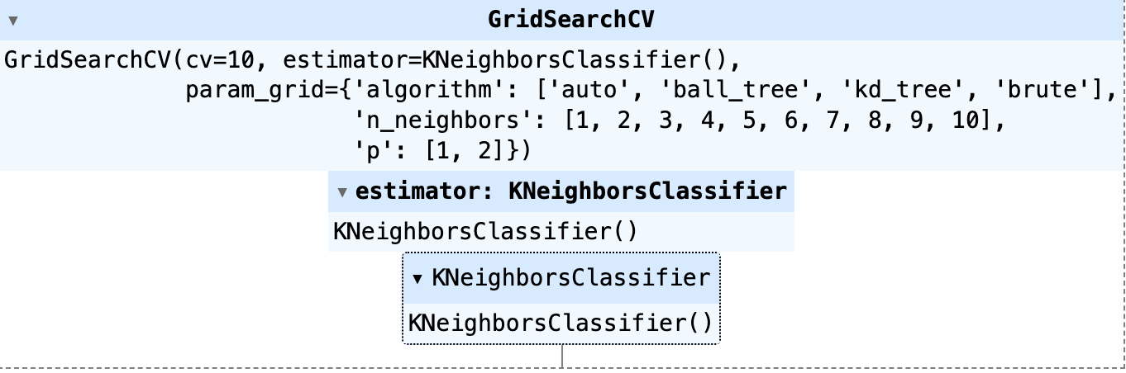
Classification Accuracy
Model | Accuracy on the validation data | Accuracy on the test data
Logistic Regression | 0.8464 | 0.8333
Support vector machine | 0.8482 | 0.8333
Decision Tree | 0.8911 | 0.8333
KNN | 0.8482 | 0.8333

Slide 44
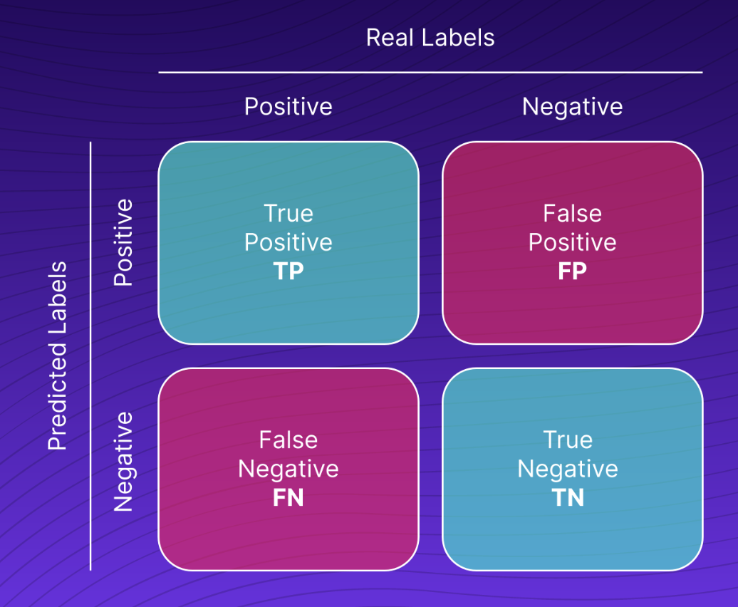
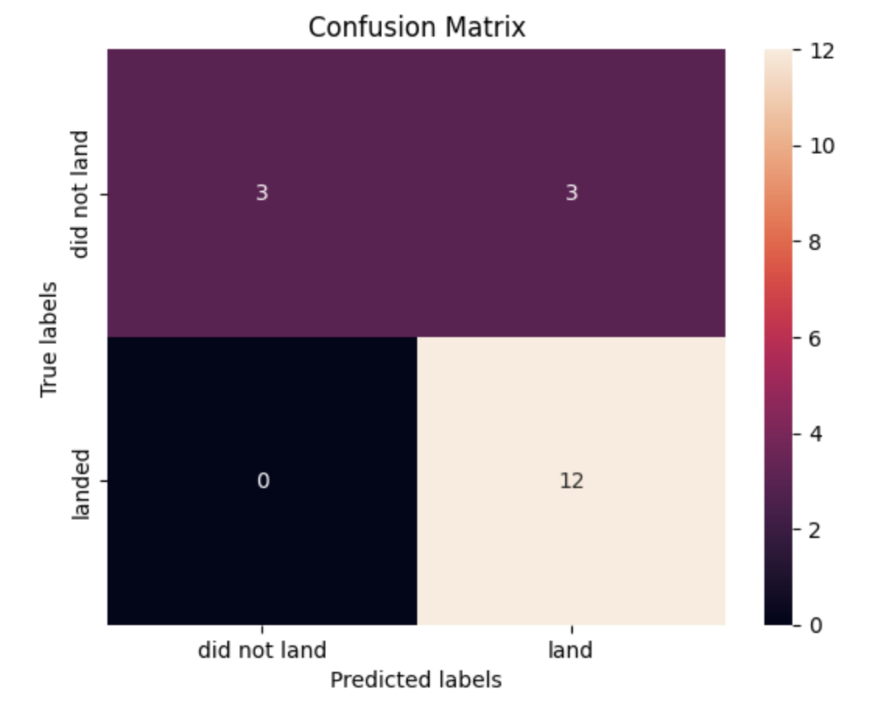
Confusion Matrix
All the predictive Analysis model has the confusion matrix are same.

Slide 45
Conclusion
As we could see from the above accuracy and confusion matrix, Decision Tree algorithm works best for the predictive analysis.
Launches with low Payload shows better result than launches with high Payload.
In Folium map, the launch sites are in close proximity with the coast.
The launch site KSC LC – 39A has highest success ratio for launching.
Predictive analysis model shows good range of performance. For the stakeholders perceptive, the pictorial representation shows better understanding than a theoretical presentation.
Many useful insights are included for further improvement in the Launching site decision making.

Slide 46
Appendix
Coursera Guidelines
GitHub Link for Python Notebook
IBM Data Science Professional

Slide 47

Thank You

